Slide 1
Neutral Note A Tool for Promoting Fairness and Objectivity in Written Texts
21911A0536 Kuppa Ksheeraja Manaswini
21911A0514 Darshitha Gongle
21911A0550 Peddolla Harika Reddy
21915A0508 Kandada Sirivennela
Making Words Matter: Enhancing Objectivity Through AI

Slide 2
Table of contents
01
07
02
08
03
06
Abstract
Architecture
Introduction
Modules
Existing System
09
Design (UML Diagrams)
04
Proposed System
10
Implementation
05
Requirements
11
Execution
Conclusion and Future Enhancements
Scope
12

Slide 3


01.
Abstract
Toxicity Detection
Identifies toxic phrases
Highlighting
Toxic sentences are highlighted
Text Input
User types text
Detects and highlights toxic text in real-time.
Based on TensorFlow’s pre-trained model.
Promotes neutral language.
Rephrasing
Detoxifies the sentence
Addressing Bias, One Sentence at a Time.

Slide 4

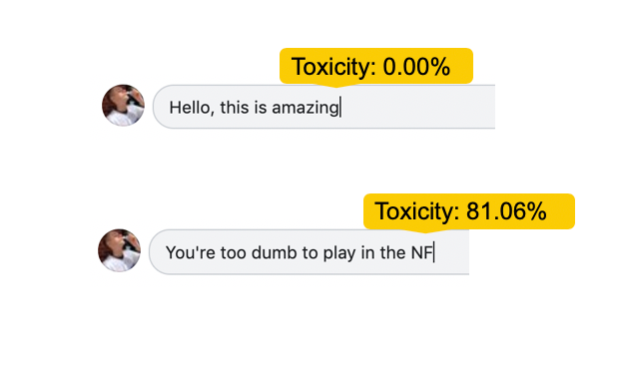
02.
Introduction
Biased language is more than just words—it shapes perceptions, influences behavior, and perpetuates stereotypes. When biases are embedded in language, they can have far-reaching consequences.
Guiding Language Towards Objectivity.

Slide 5





03.
Existing System
Grammarly
Quillbot
Facebook
Instagram
X
Harnessing AI to Detect and Correct Bias.

Slide 6

04.
Proposed System using Detoxify model
It can detect multiple types of toxic behavior, classified into different attributes: Toxicity, Severe Toxicity, Identity Attack, Insult, Threat, Obscene, Sexually Explicit
Provides a thorough analysis to ensure a fair detection of toxicity considering the context.
User Friendly Interface
Expanding Horizons, Enhancing Accuracy.

Slide 7

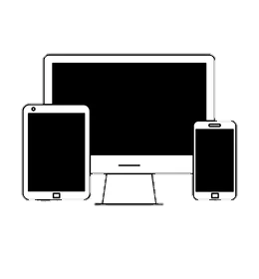



05.
Requirements
Hardware
Software
1. Server or Cloud platform for hosting the web application
2. User Devices (PCs, Tablets, Smartphones) for accessing the application
3. Development Machine (RAM: 8GB or higher)
1. Frontend: HTML, CSS, JavaScript 2. Backend: Django Framework (4.1.13) , Detoxify (Python Package), Python (3.10.2), OpenAI (0.28)
3. Database: Maria DB (10.4.32), Django ORM
Promoting positive communication through Technology

Slide 8

06.
Scope
Content Moderators, Users and Writers
Toxicity Detection
Rephrasing Suggestion
Real-time feedback
Quantifying the Impact of Bias Detection

Slide 9

07.
Architecture
User Text
Text Processing Logic
Detoxify
Neutralizer
User Authentication
MariaDB
Client Side
Server Side
Database
Django Web Server
Fostering a safer online environment for all users

Slide 10

08.
Modules
User Authentication Module
Text Input Module
Toxicity Detection Module
Rephrasing Module
Display Output Module
Demonstrating effectiveness in identifying and neutralizing toxicity

Slide 11
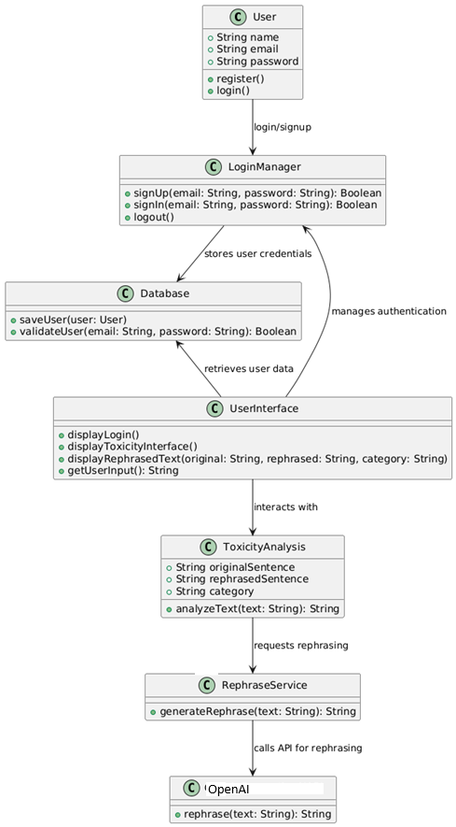
09.
Design (UML Diagrams)
Class Diagram
Understanding the structure and components of our system

Slide 12
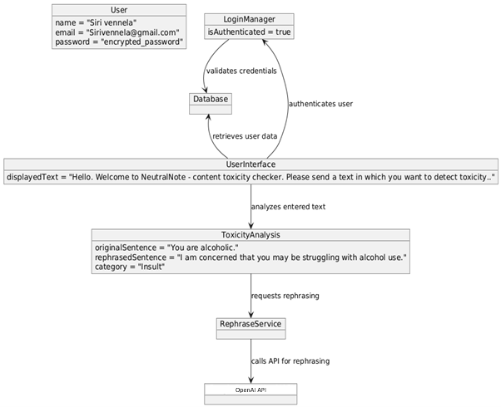
Object Diagram
Empowering positive communication with AI-driven rephrasing.

Slide 13
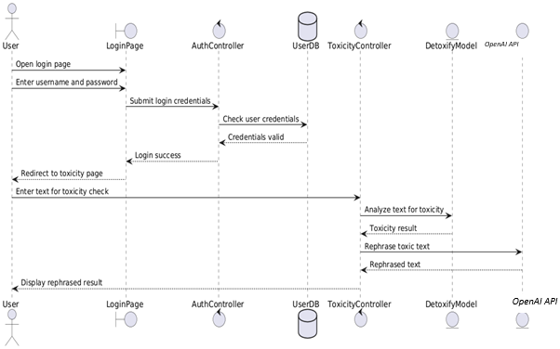
Sequence Diagram
Visualizing the interactions between user and system

Slide 14
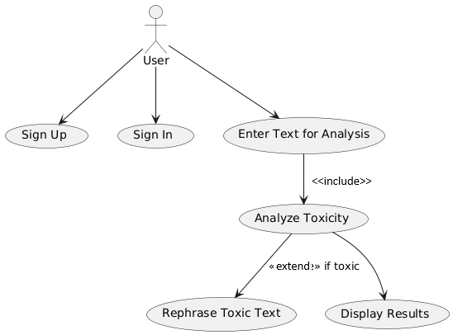
Use Case Diagram
Ensuring a seamless user experience with intuitive design

Slide 15
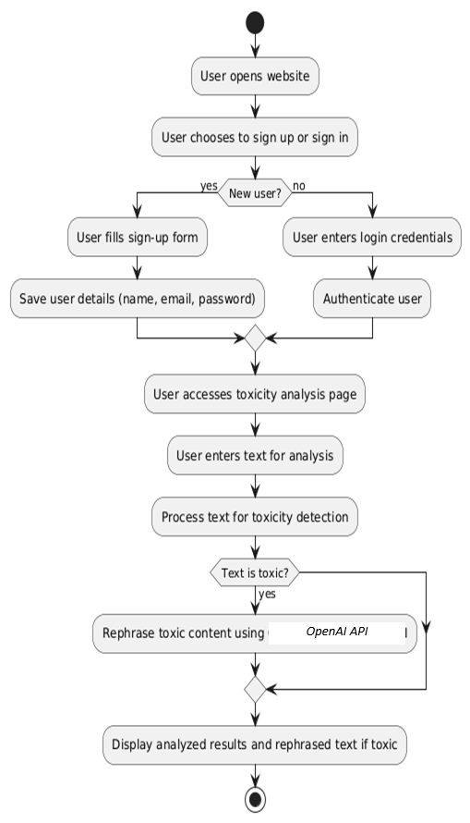
Activity Diagram
Mapping the user journey

Slide 16
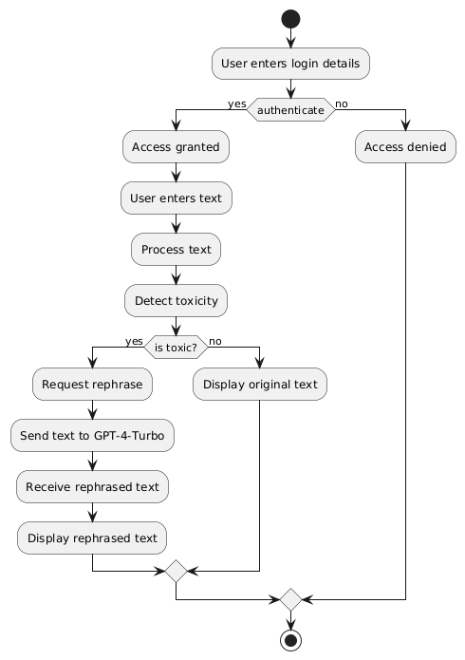
State Diagram
Addressing toxicity online to foster safer digital spaces.

Slide 17
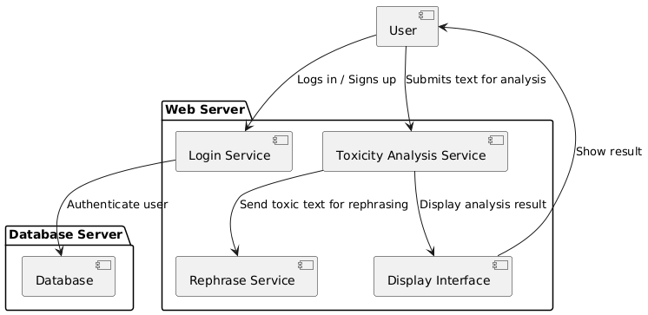
Component Diagram
Transforming Toxic Text into Positive Conversations

Slide 18
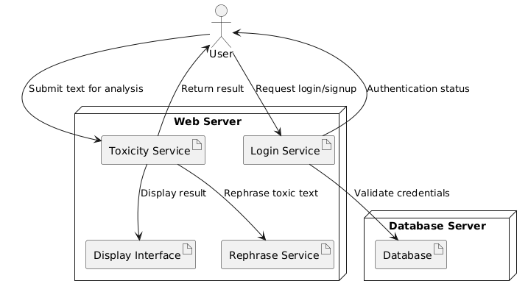
Deployment Diagram
Combating negativity in online interactions—one sentence at a time.

Slide 19
10.
Implementation
Self attention mechanism
Transformer-based Architecture
User Authentication
Using XAMPP’s MariaDB (10.4.32)
Framework
Django Framework (4.1.13)
Detoxify
Based on BERT
Loss Function
512 tokens
Large-scale pretraining and Fine-tuning (8192 tokens)
Probabilistic Generation Algorithms
Using Django’s Front-End Development Interface (static, templates) by inhibiting HTML, CSS, JavaScript (AJAX)
Using Django’s Backend Interface (views.py) to inhibit the detection and rephrasing logic
Using Django’s settings.py to configure the databases
Using Django’s migrations to create tables and authentication
Using JWT Encoding Algorithm for the password
6 categories
OpenAI GPT 4
Transforming design into a functional application

Slide 20
Test cases
Test Case Name | Description | Result
User Authentication | User’s details being saved into the database seamlessly and no issues while logging in, being able to recognize invalid formats | PASS
Detecting Toxic Sentences | Detecting toxic sentence along with its category (Example: You are the worst person I have met) | PASS (Toxic and category: Insult)
Detecting Non-Toxic Sentences | Detecting non-toxic sentences (Example: I love playing games) | PASS
Rephrasing Toxic Sentences | Being able to rephrase toxic sentences (Example: You are the worst person I have met) | PASS (I have not had a positive experience with you)
User Security | Storing the encrypted passwords using the algorithm HS256 | PASS
Effective detection and rephrasing performance with positive feedback.

Slide 21
11.
Execution
Insult
Identity Attack
Insult
Identity Attack
Identity Attack
Insult
Encouraging outcomes in reducing harmful content online.

Slide 22
Results
Metric Name | Result
Response Time | ~5-7 seconds
Accuracy | 91%
Precision | 89%
Recall | 88%
F1 Score | 88.4%
False Positive Rate | 5%
False Negative Rate | 6%
Assessing impact through precision, recall, and user satisfaction.

Slide 23
12.
Conclusion
Promoting positive online interactions
High Accuracy
User satisfaction and Accessibility
Addressed challenges such as minimizing false positives and refining rephrasing quality to improve user experience.
An impactful step forward in reducing online toxicity.

Slide 24
Future Enhancements
Ensemble Learning
User Customization
Integration with social media platforms
Advanced Analytics and Reporting
Scaling the impact with advanced features and collaborations.

Slide 25
Thanks!
Do you have any questions?
manaswinikk2004@gmail.com
harikareddy.kushlu@gmail.com
darshithagongle@gmail.com
kandadasirivennela@gmail.com
Together, We Make Words Matter.

